Slide 1


SR University
2022-23

Slide 2
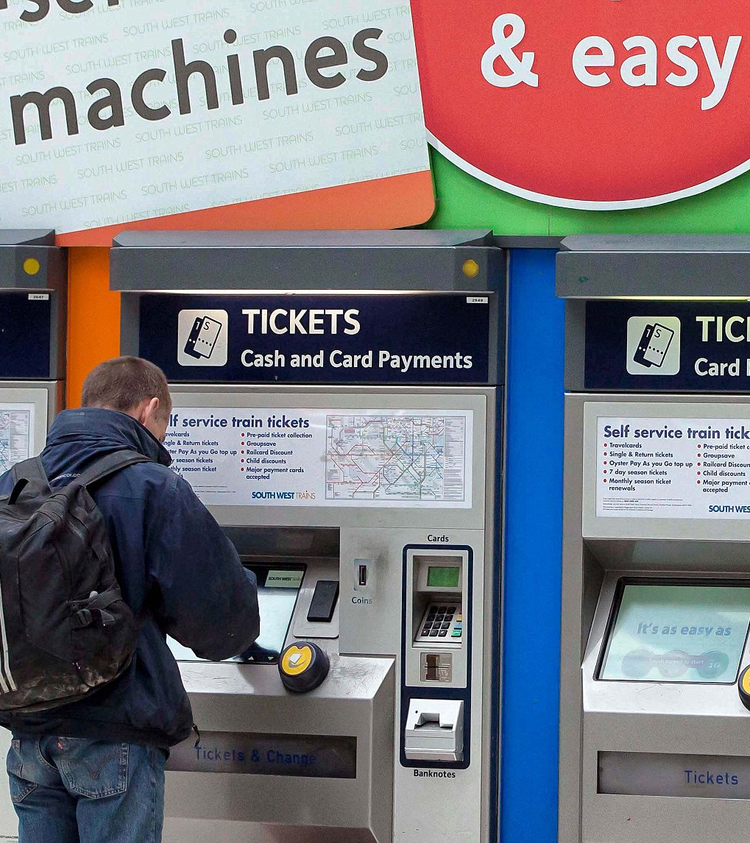
Metro Ticket Booking
2103A54008
P.AJAY GOUD
CSE –DS (2nd year)
Guided by:- Dr.A.Siva Krishna Reddy

Slide 3
Agenda
1
2
3
4
5
INTRODUCTION
OBJECTIVES
BLOCK DIAGRAM
&
ADVANTAGES
SAMPLE OUTPUTS
CONCLUSION

Slide 4
Manual services are inefficient and costly. Also, consumers’ attitudes toward consumption have gradually shifted from pragmatism to hedonism.
PROBLEM STATEMENT

Slide 5
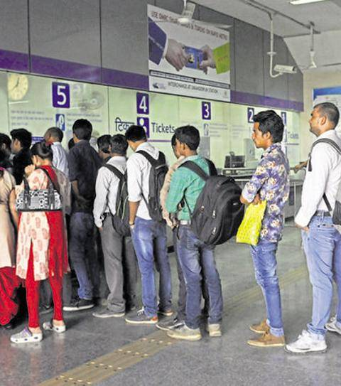
Introduction
The main aim of the project is booking a ticket through a system without any human interaction. As many machines can be installed, waiting in queue is no longer needed.

Slide 6
Objective:-
It makes you easy way to buy tickets.
Its reduces time instead of waiting in a queue.
It run automatically by computer without any interference.
There are five options
1.view Stations
2. Buy tickets
3.create card
4.delete card
5.Travellers History

Slide 7
BLOCK DIAGRAM:-
VIEW STATIONS
BUY TICKETS
CHOICE
CREATE CARD
DELETE CARD
TRAVELERS HISTORY

Slide 8

Hardware and Software Requirements
System development hardware
CPU : ryzen 5, 3.0 GHz
RAM : DDR4 16GB
SSD : 512GB
Monitor : Color monitor
User hardware requirement
CPU : Intel Pentium 4,2.0 GHz
RAM : DDR2 1GB
HDD : 80 GB
Monitor : Color monitor
Software requirement
Dev C++
(or)
Any IDE for C

Slide 9
Advantages:-
We can create our own card.
We can delete our existing card.
We can buy tickets through cash or card.
We can see Travellers history

Slide 10
Sample code:-
void green();
void blue();
void red();
void green1();
void blue1();
void red1();
int ajay(int);
void buy();
void morebuy();
void create_card();
void delete_card();
void ajaycash();
void pay_cash();
void pay_card();
void time1();
void colors();

Slide 11
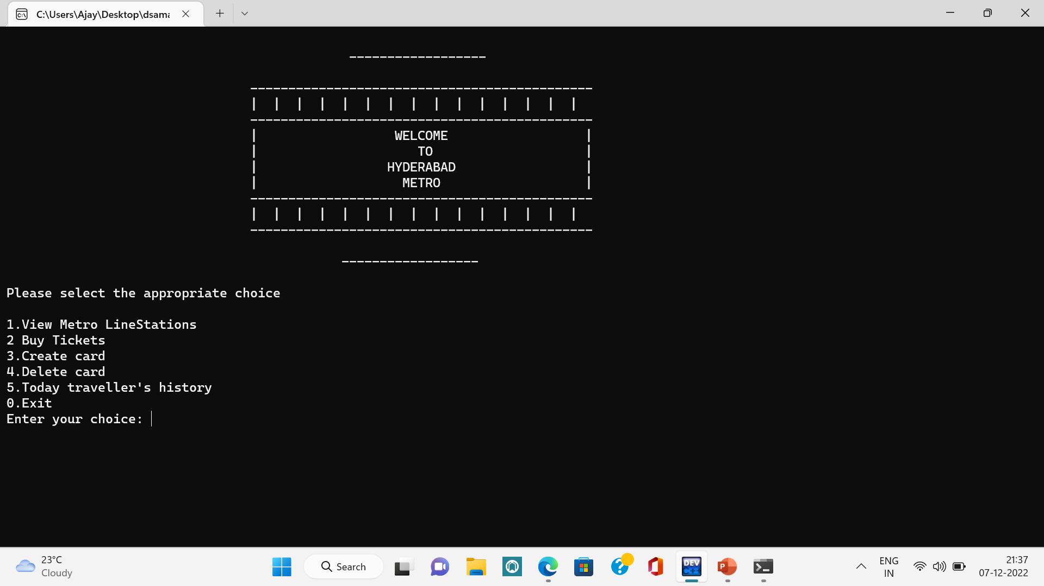

Slide 12
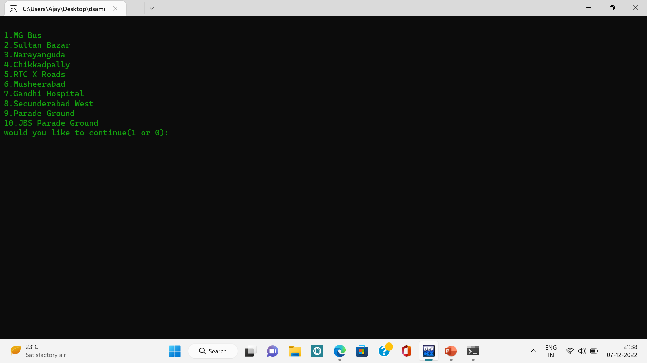

Slide 13
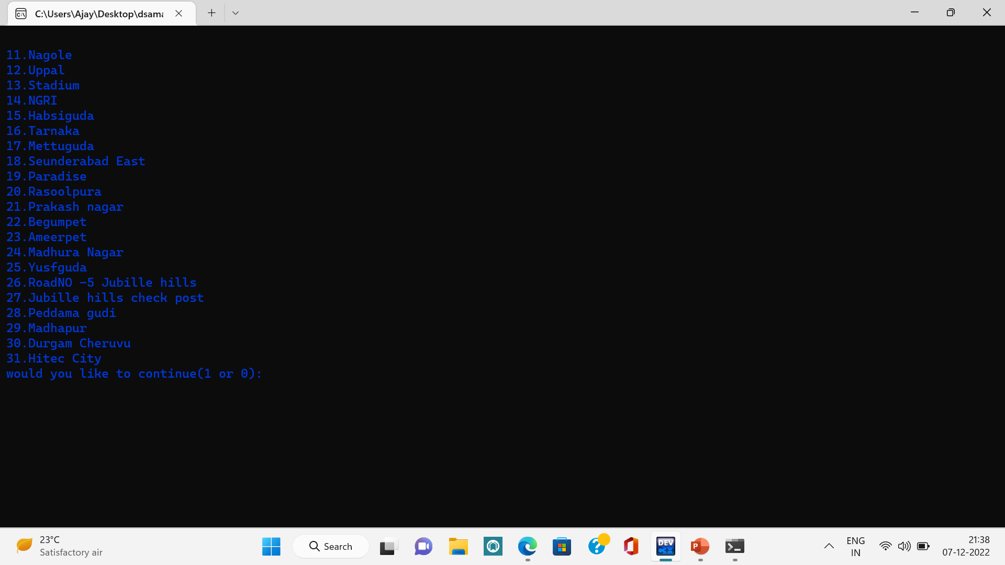

Slide 14
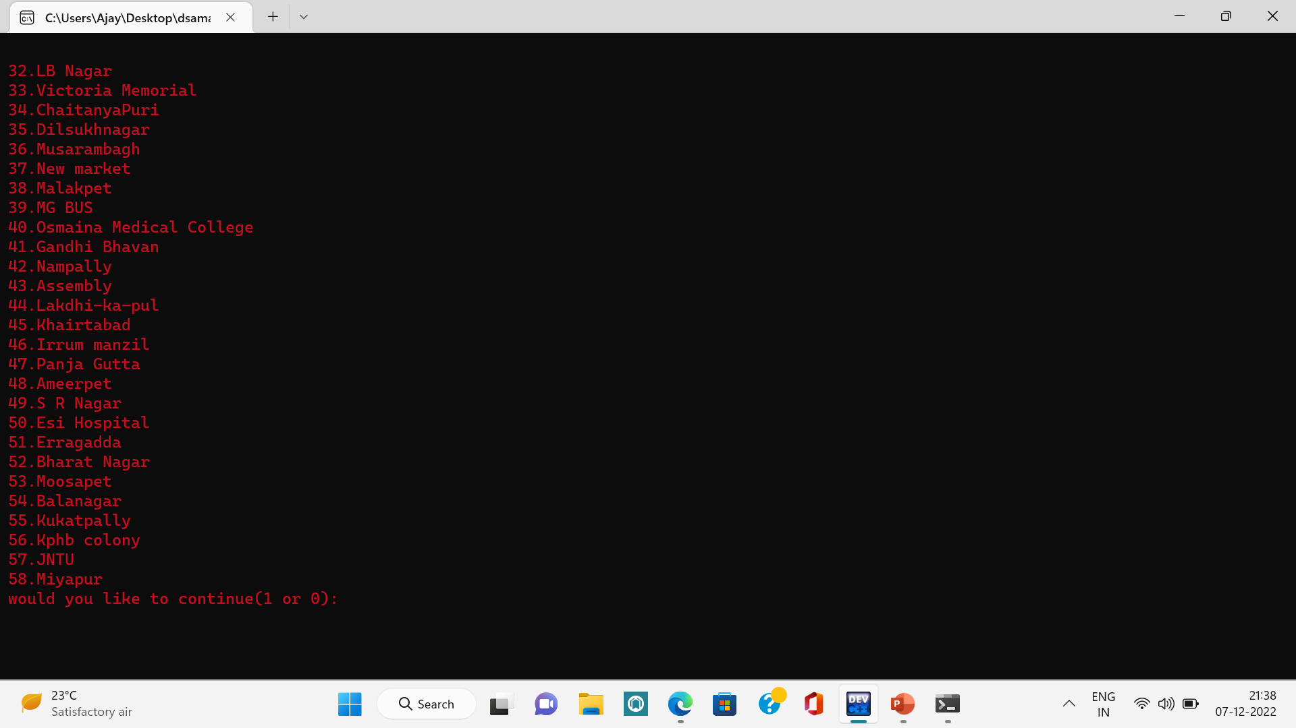

Slide 15
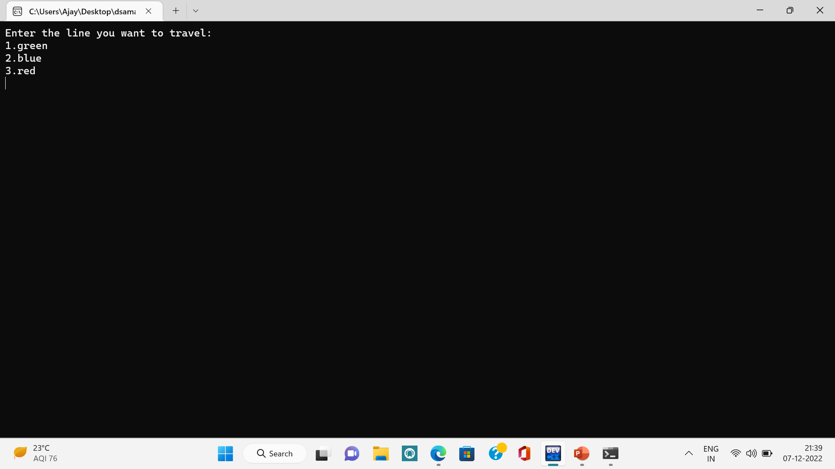

Slide 16
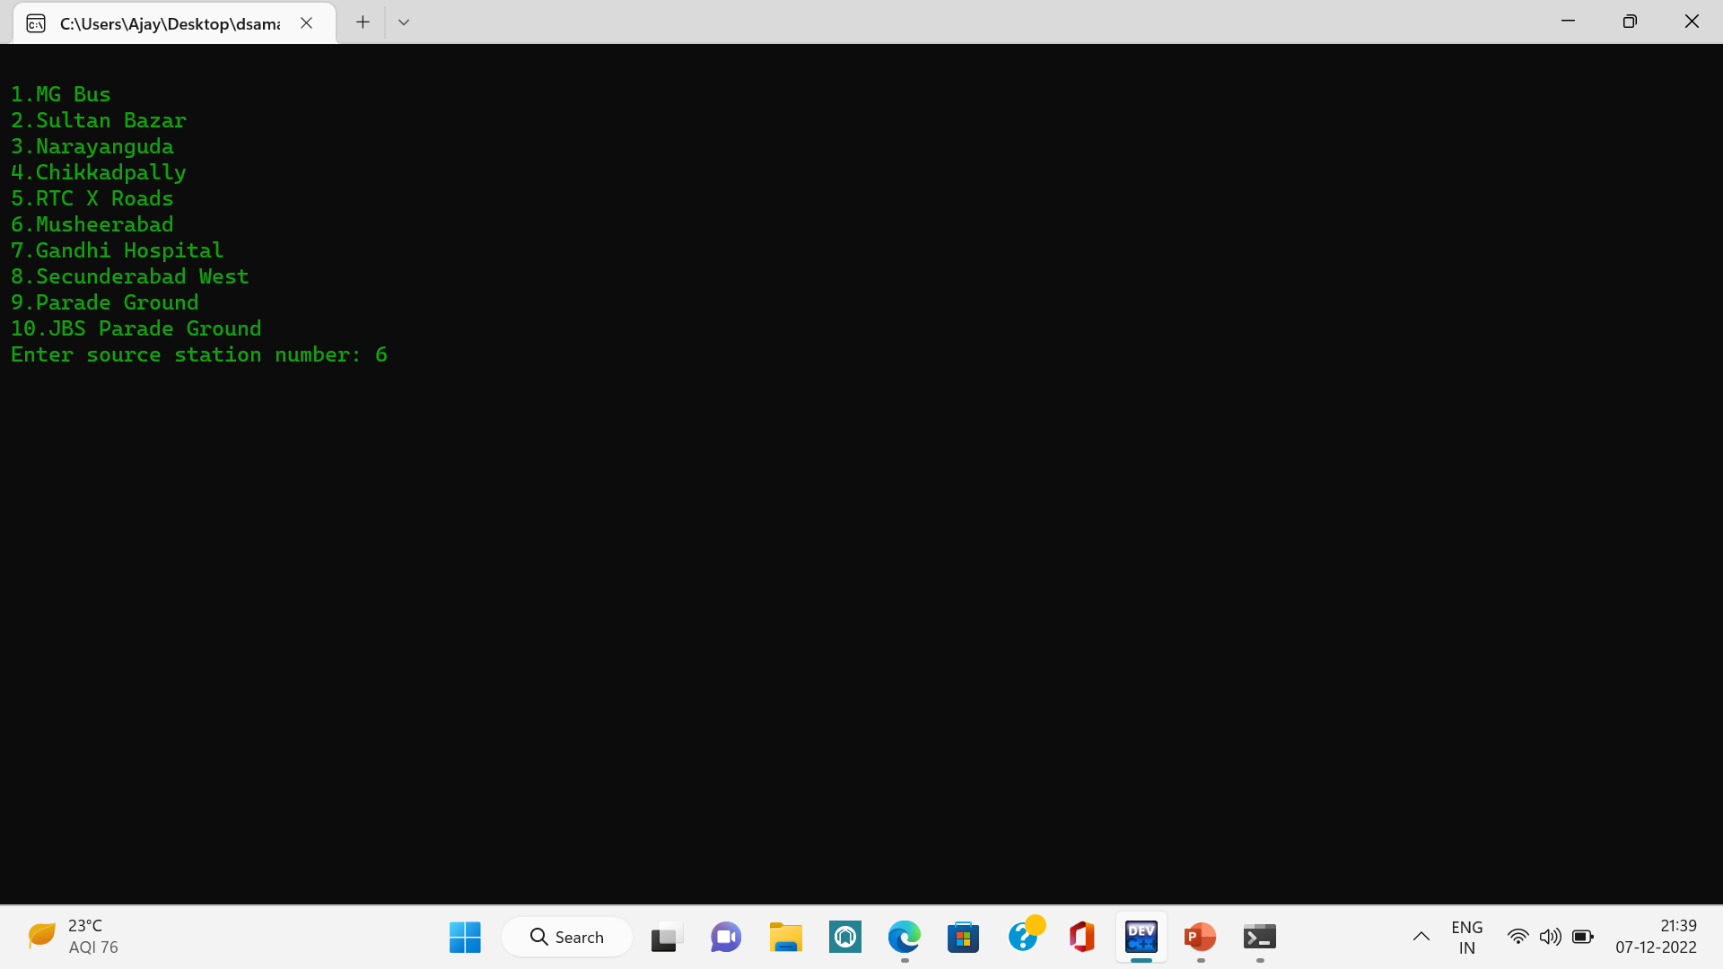

Slide 17
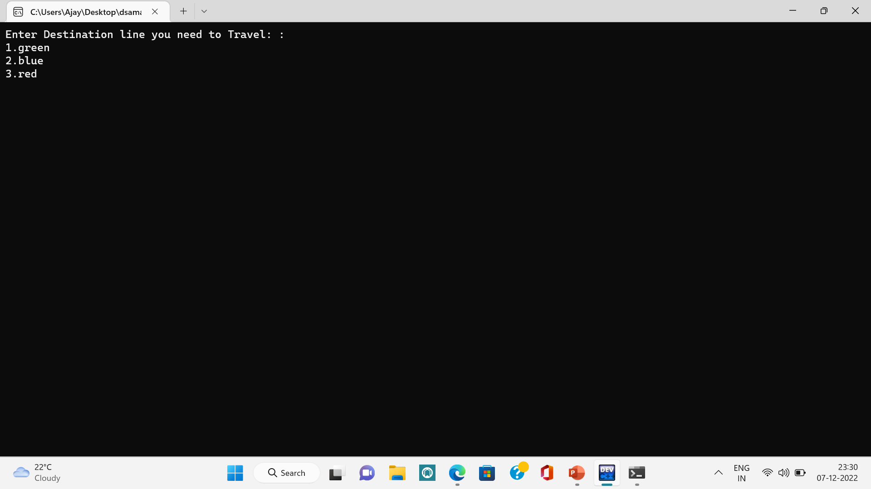

Slide 18
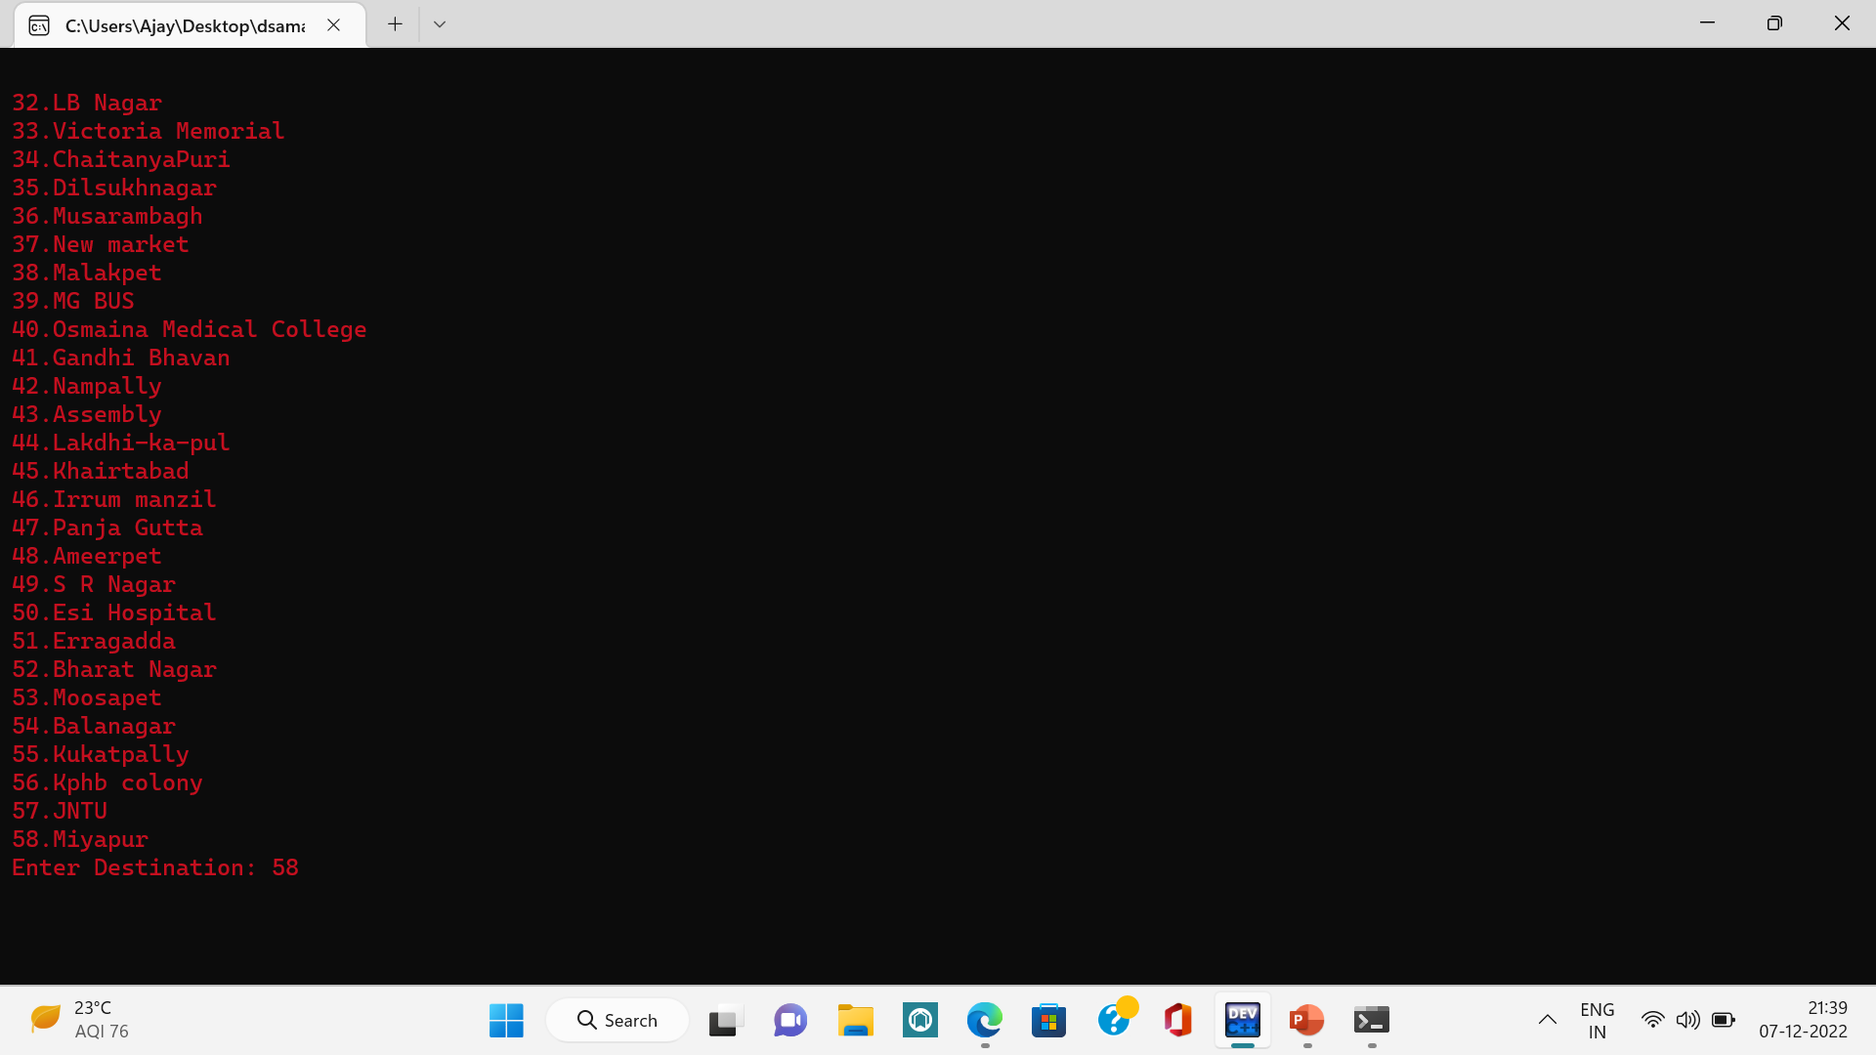

Slide 19
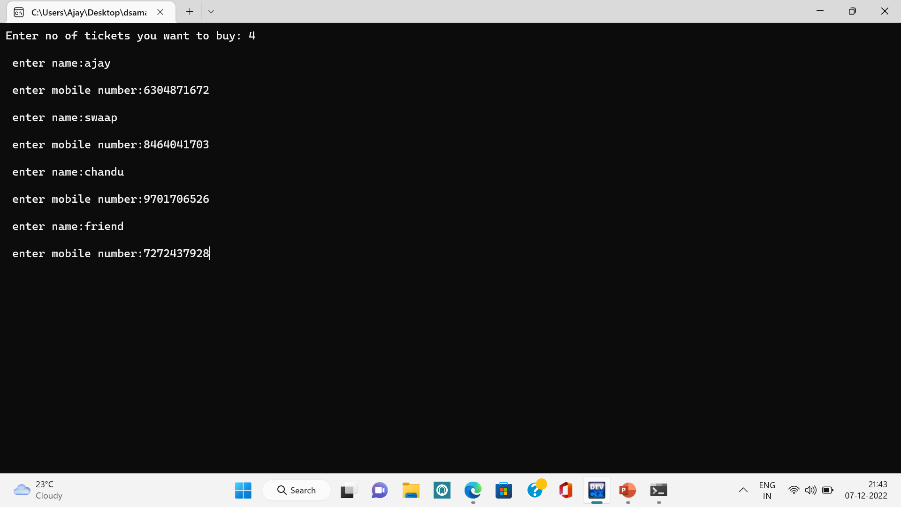

Slide 20
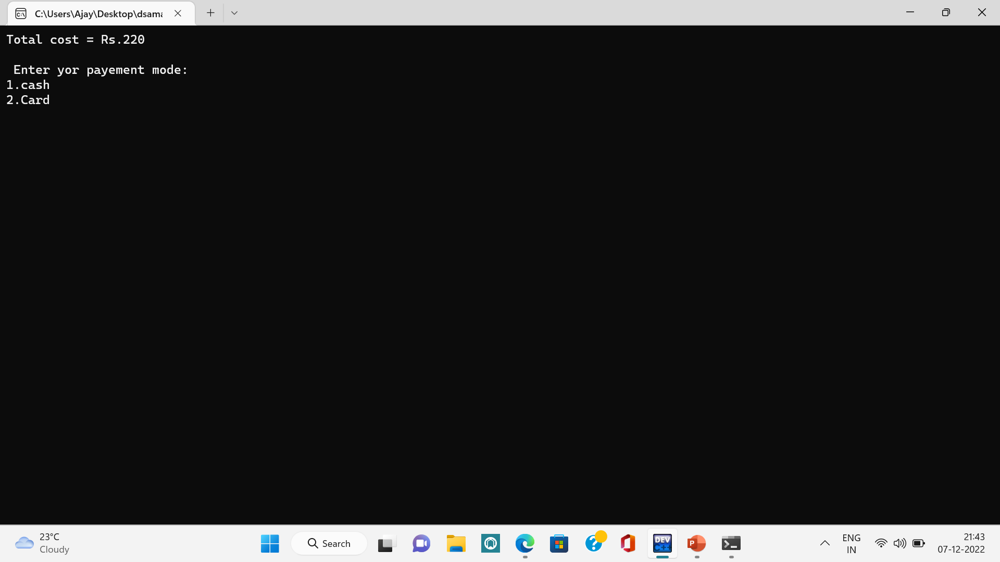

Slide 21
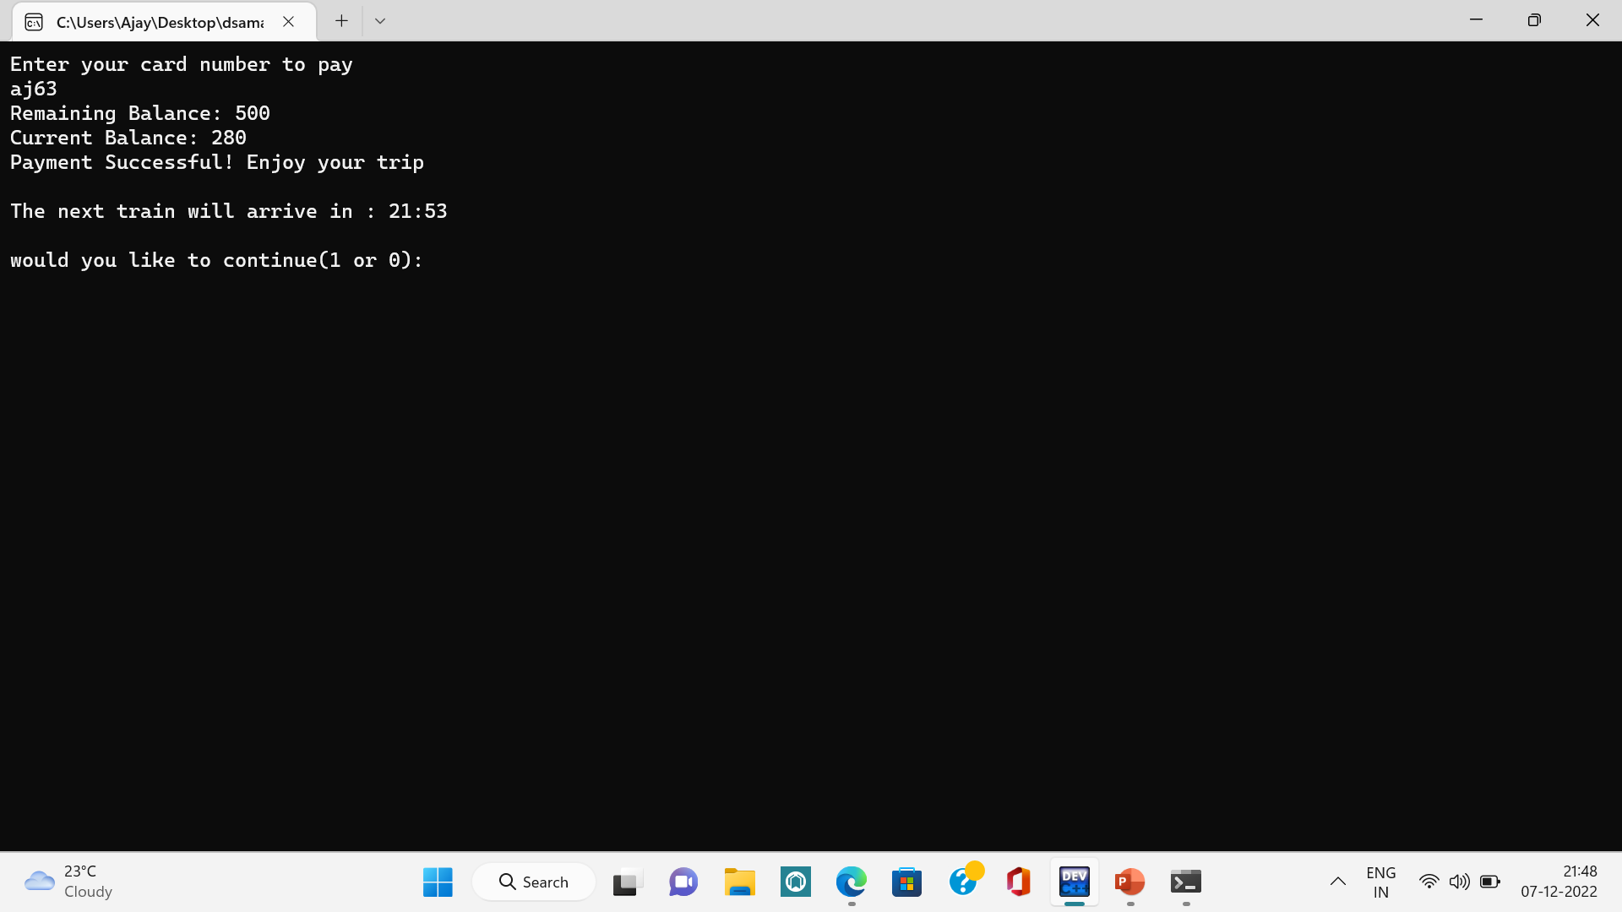

Slide 22
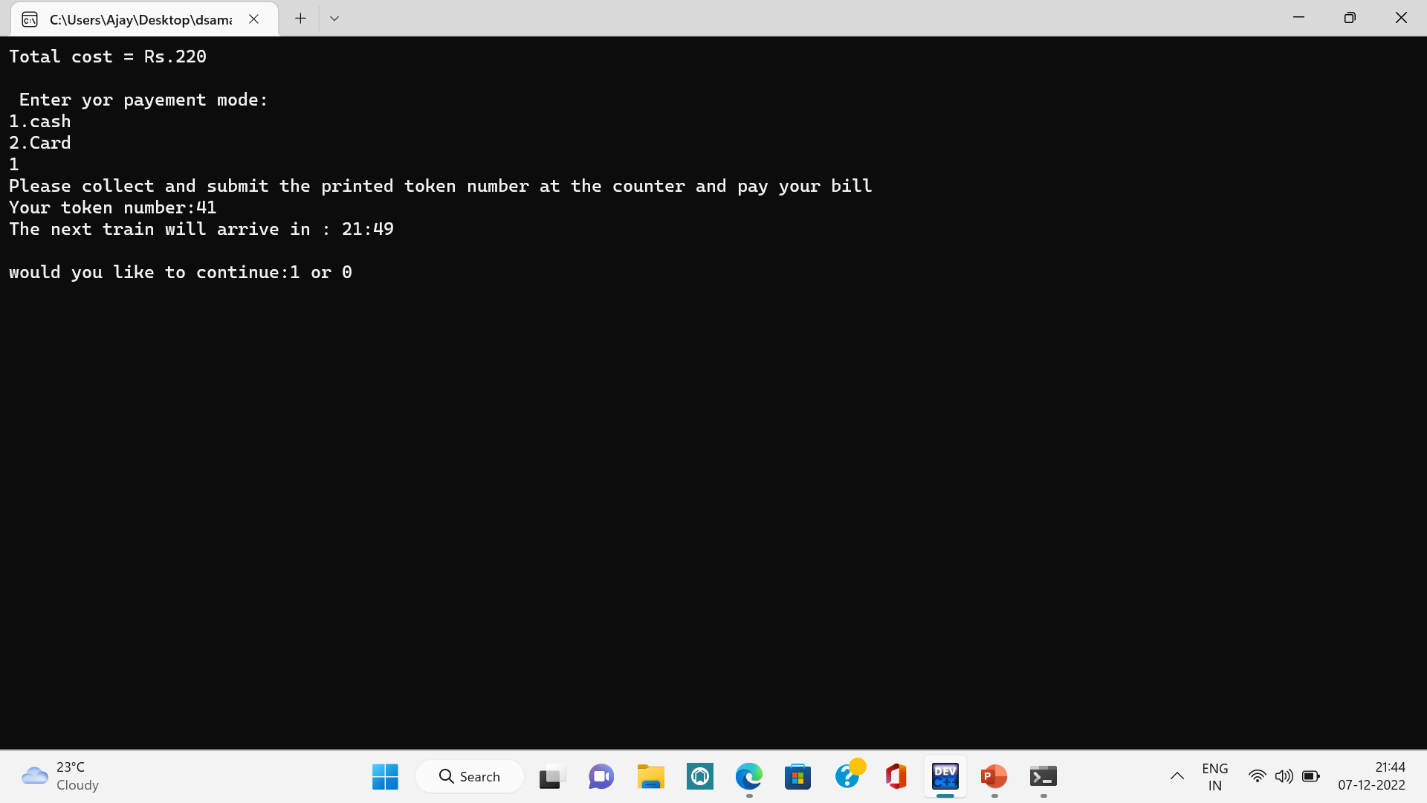

Slide 23
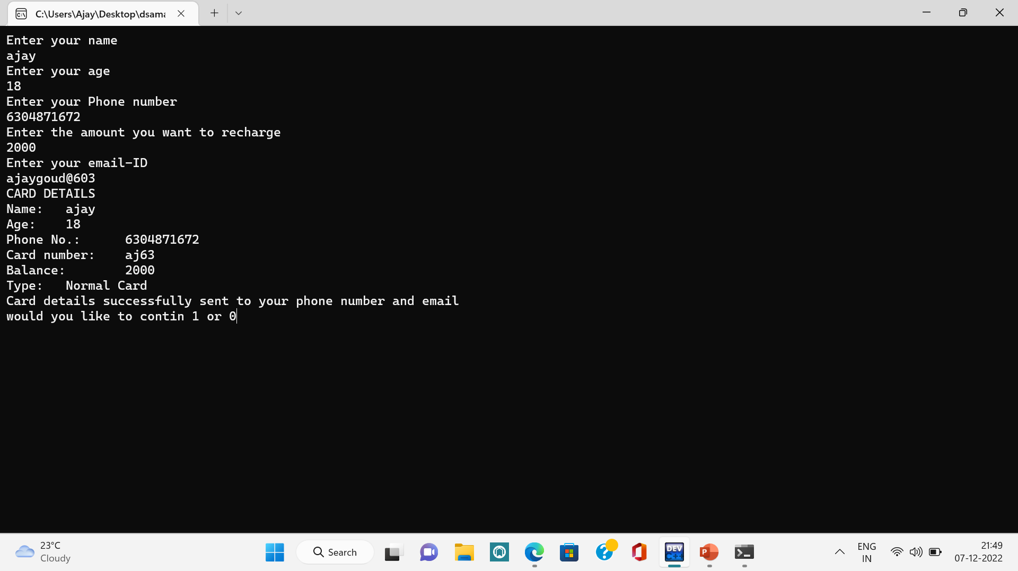

Slide 24
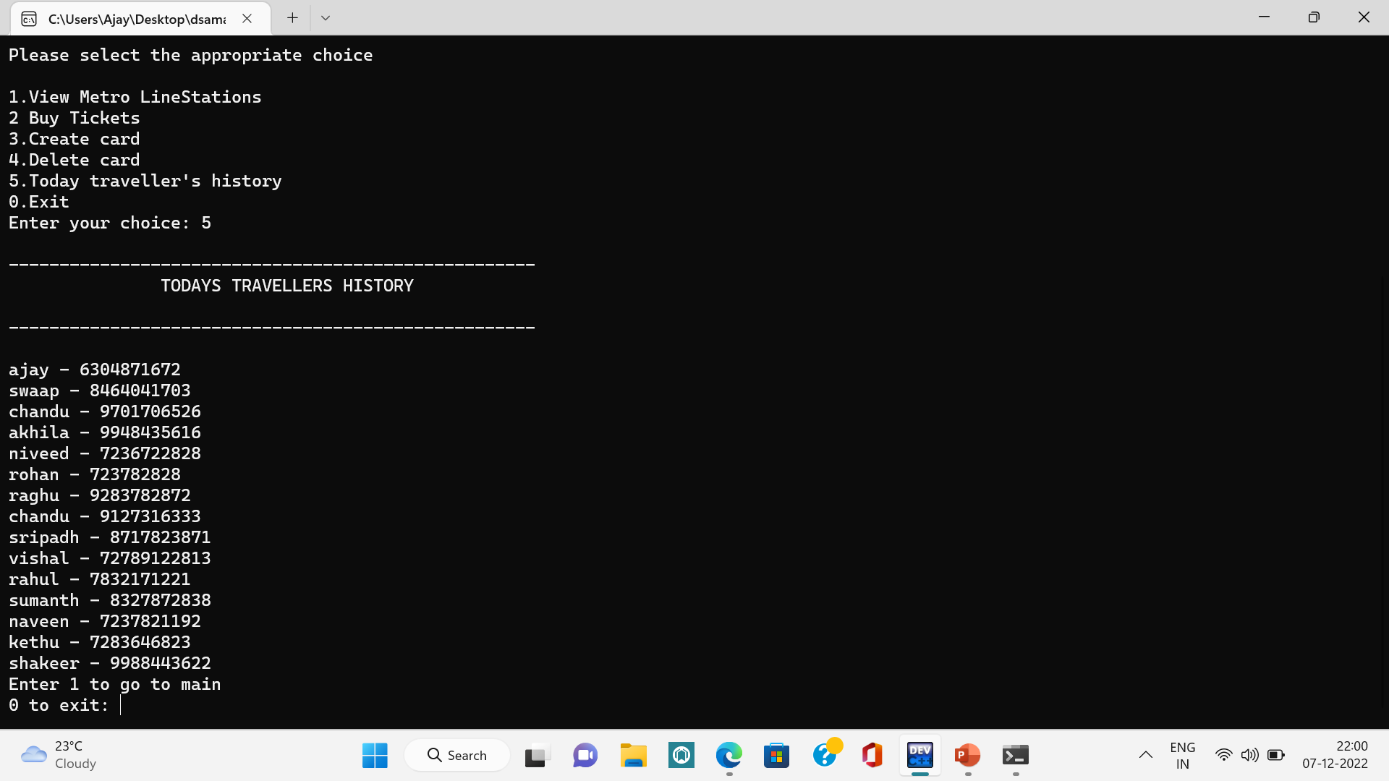

Slide 25
The project has been a rewarding experience for me in more ways than one. This represents a typical real-world situation. This has been strengthened my understanding of building a project. As everything in the world have pros and cons, this project also has cons. A disadvantage of my project is it cannot store the data forever.
Conclusion:-

Slide 26
REFERENCES:-
C Language:-
C Programming Language – GeeksforGeeks
Data Structures:-
Data Structures - GeeksforGeeks
GitHub - gdeepank/C-Project: Metro Rail Reservation Syste

Slide 27


Thank you

